Slide 1
SAP EWM EXTENDED WAREHOUSE MANAGEMENT TRAINING
AnubhavTrainings.com
www.anubhavtrainings.com

Slide 2

SAP EWM TRAINING
BY:-
Mr. Bijoy
www.anubhavtrainings.com
Notes:
https://unsplash.com/photos/uXB-7la5vqA

Slide 3
SAP EWM TRAINING (Day 11)
AnubhavTrainings.com

Slide 4
WOCR & Wave Management
Concept of WOCR and related parameters
Warehouse Order Creation rule Configuration
Process Maintain Wave types, Wave categories, Automatic Wave, Maintain Wave template
Manual & Automatic Wave creation testing

Slide 5
YARD MANAGEMENT
You use Yard Management to manage your yards. The yard is where you maintain vehicles and transportation units that arrive or depart.
YM enables you to manage the following yard processes:
Check-in and check-out of vehicles
Scheduling of doors and staging areas for vehicles (manually or based on the system's automatic scheduling mechanism)
Creation and execution of movements in the yard (manually or based on the system's location determination mechanism)
Creation and execution of operations in the yard, such as weighing and sealing/un-sealing of vehicles
Registration of the start and finish of loading and unloading of vehicles (by delivery or for whole vehicle)
www.anubhavtrainings.com

Slide 6
Provision of Information to Forwarding Agents
YM provides Business Partners, such as freight forwarders, with information on their vehicles, including time in yard, current location and processing status. This information may be provided either via the ERP system or via the Web.
Yard is a location outside the warehouse where the vehicle/TUs will arrive & leave to load and unload the goods. It is usually implemented to manage the truck movements within the yard. Below are the important aspects of a yard management.
Check Point: A check point is a location where the truck will enter & leave from the warehouse after completion of loading & unloading of goods. In simple words, it’s the gate for the yard.
Parking Spaces: A parking space is a location within the yard where the truck will be parked temporarily when the doors are not free. In case if the doors are free, then truck will be moved directly to the warehouse door from checkpoint.
www.anubhavtrainings.com

Slide 7
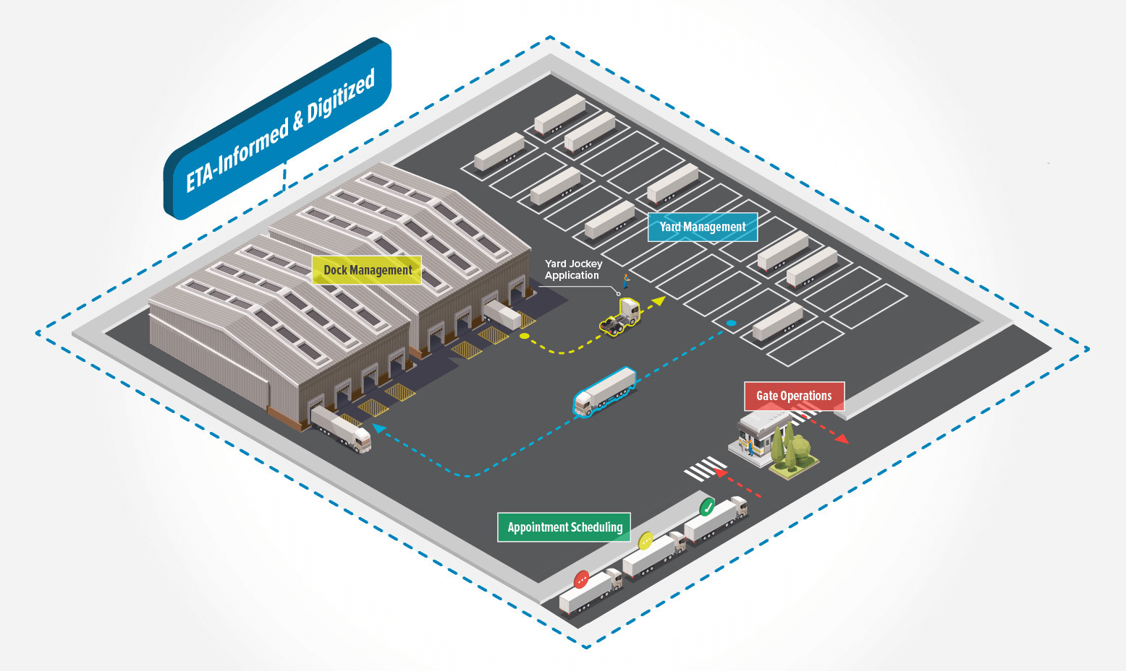
Door: A door is a location where the truck arrives to load and unload the goods. After completion of loading/unloading the truck will leave from the warehouse through checkpoint.
www.anubhavtrainings.com

Slide 8
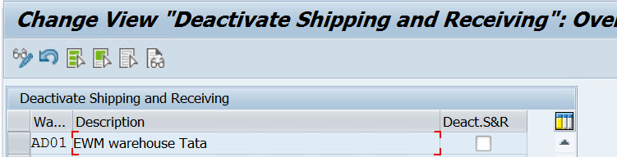
ACTIVATE THE SHIPPING & RECEIVING IN THE WAREHOUSE
When you deactivate, the transportation unit, vehicle and door (occupancy) objects and their respective dependencies (assignment of transportation units to vehicles, occupancy of doors by vehicles, assignment of deliveries to transportation units, and so on) are no longer available.
SPRO -> IMG -> SCM Extended Warehouse Management -> Extended Warehouse Management -> Cross process setting -> Shipping and Receiving-> General settings -> Deactivate Shipping & Receiving for warehouse
www.anubhavtrainings.com

Slide 9
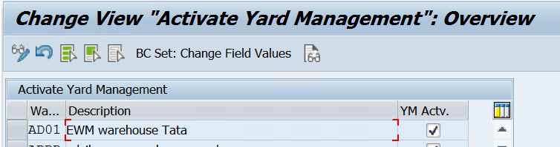
ACTIVATE YARD MANAGEMENT FOR WAREHOUSE
SPRO -> IMG -> SCM Extended Warehouse Management -> Extended Warehouse Management -> Cross-Process Settings -> Shipping and Receiving->Yard Management-> Activate Yard Management for Warehouse
www.anubhavtrainings.com

Slide 10
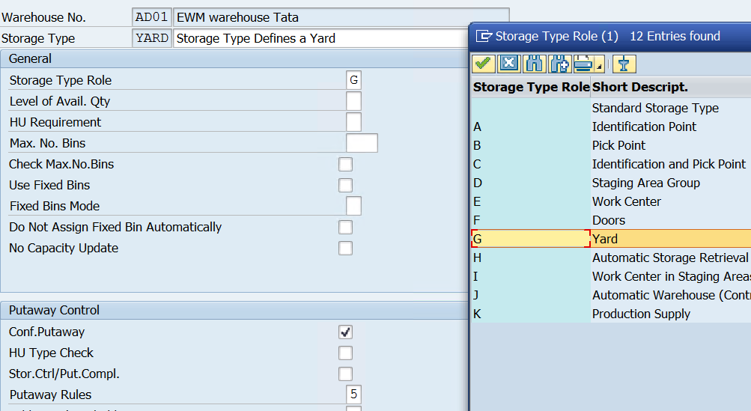
CREATE STORAGE TYPE & STORAGE SECTION FOR YARD
Yard management is largely based on the existing warehouse structures. If you want to use yard management, you must set up at least one separate storage type. You must create this storage type with the storage type role Yard
SPRO -> IMG -> SCM Extended Warehouse Management -> Extended Warehouse Management -> Master Data -> Define Storage Types

Slide 11
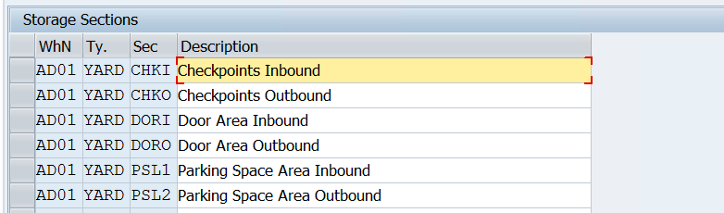

Slide 12
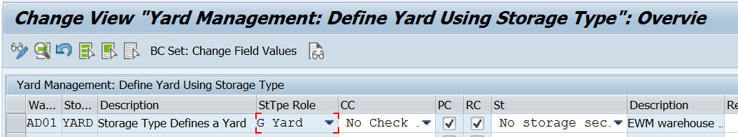
SET UP YARD
Yard management is largely based on the existing warehouse structures. If you want to use yard management, you must set up at least one separate storage type. You must create this storage type with the storage type role Yard
SPRO -> IMG -> SCM Extended Warehouse Management -> Extended Warehouse Management -> Master Data -> Shipping and Receiving-> Yard Management
Define Yard using Storage type

Slide 13
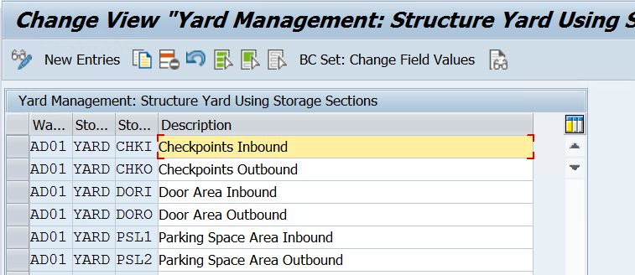
Structure Yard using Storage areas
www.anubhavtrainings.com

Slide 14
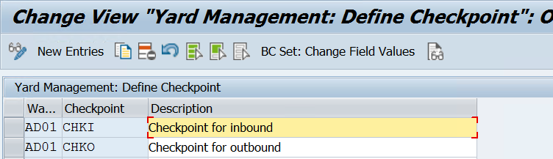
Define Checkpoints
www.anubhavtrainings.com

Slide 15
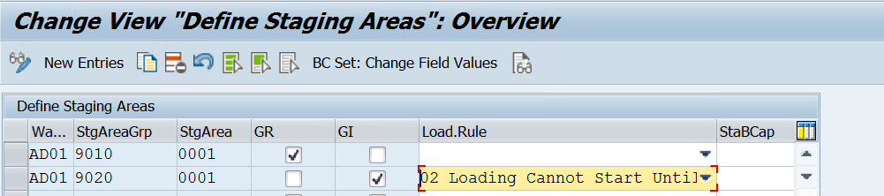
DEFINE STAGING AREA & STAGING AREA & DOOR DETERMINATION GROUP
SPRO -> IMG -> SCM Extended Warehouse Management -> Extended Warehouse Management -> Master Data -> Staging area
www.anubhavtrainings.com

Slide 16
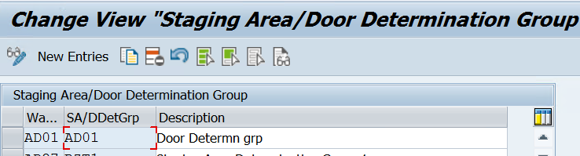
www.anubhavtrainings.com

Slide 17
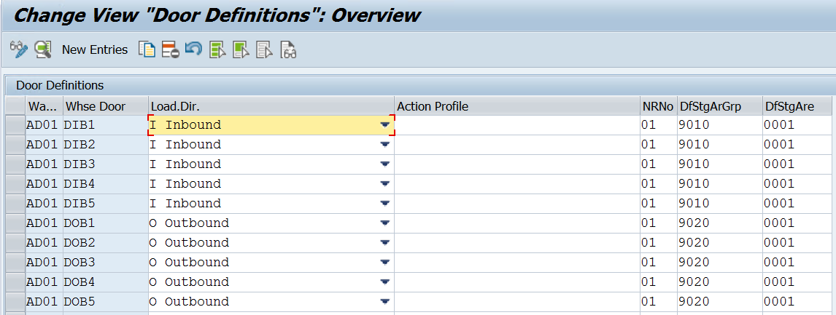
DEFINE WAREHOUSE DOOR
SPRO -> IMG -> SCM Extended Warehouse Management -> Extended Warehouse Management -> Master Data -> Warehouse Door
www.anubhavtrainings.com

Slide 18
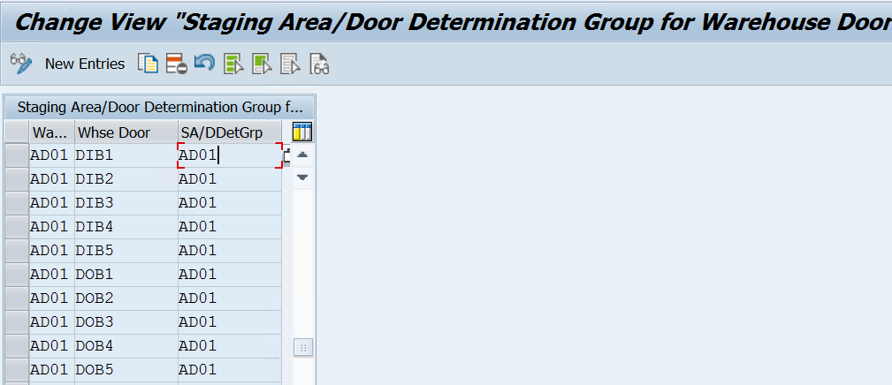
Assign staging area/door determination group to door
www.anubhavtrainings.com

Slide 19
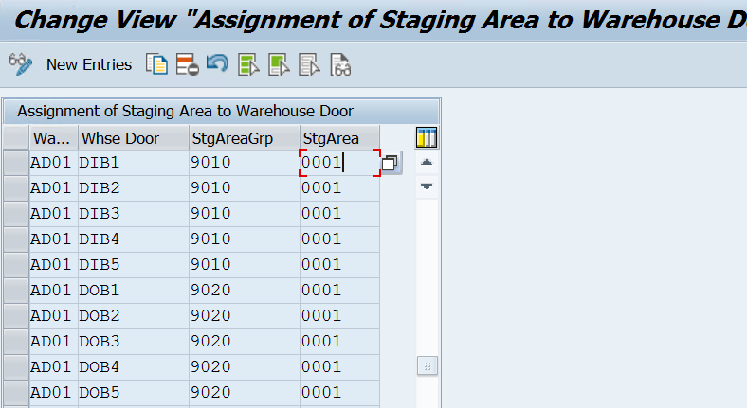
Assign Staging Area to Doors
www.anubhavtrainings.com

Slide 20
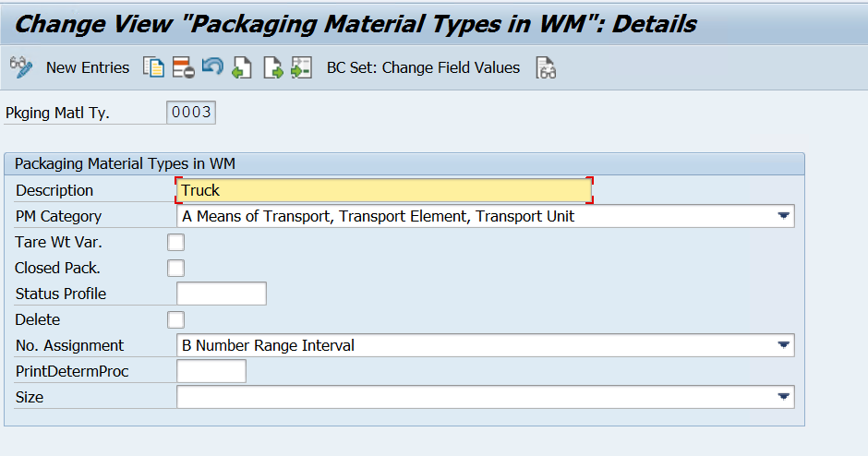
DEFINE PACKAGING MATERIAL TYPE
www.anubhavtrainings.com

Slide 21
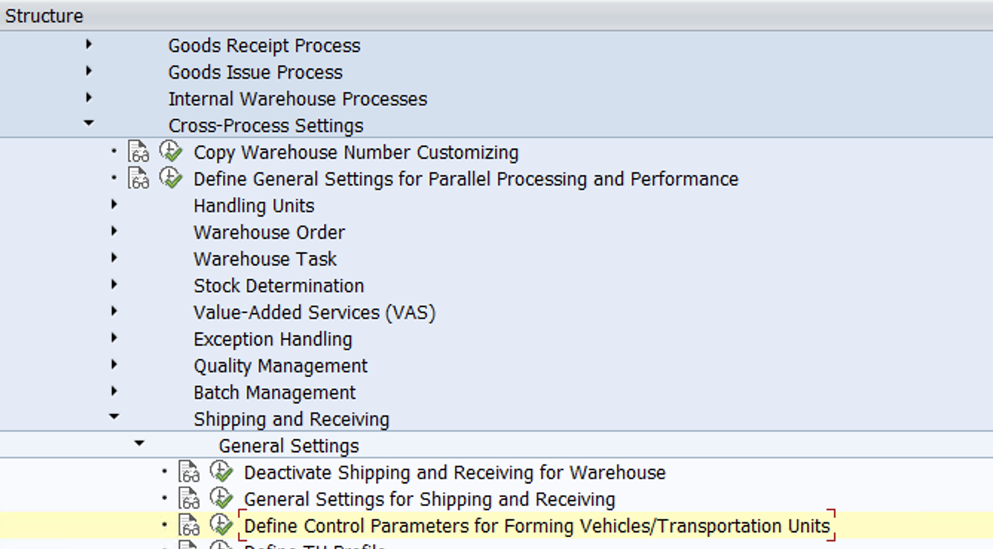
DEFINE CONTROL PARAMETERS FOR FORMING VEHICLE
www.anubhavtrainings.com

Slide 22
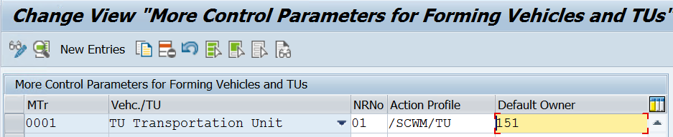
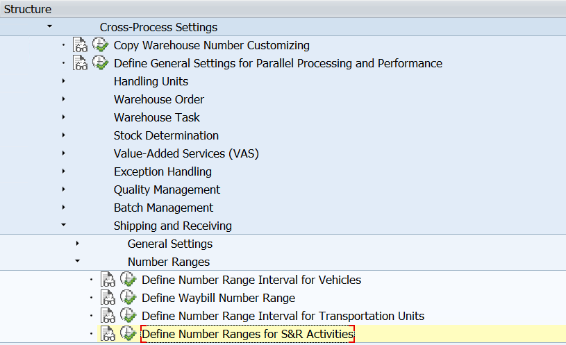
Define number ranges for transportation unit
www.anubhavtrainings.com

Slide 23
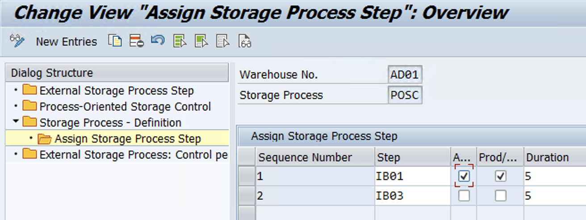
Maintain POSC Configuration (Optional)
Use Standard External Steps -
IB01 - Unloading
IB03 - Putaway
www.anubhavtrainings.com

Slide 24
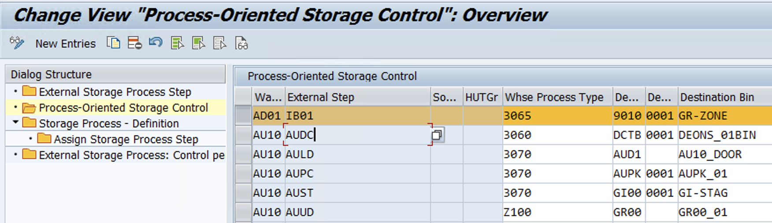
www.anubhavtrainings.com

Slide 25
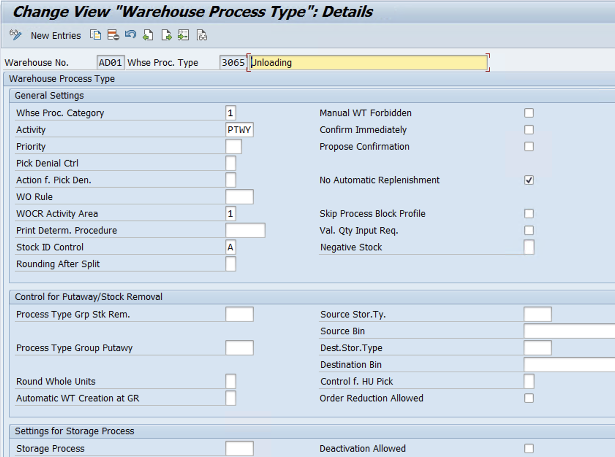
Define WHPT for Unloading
www.anubhavtrainings.com

Slide 26
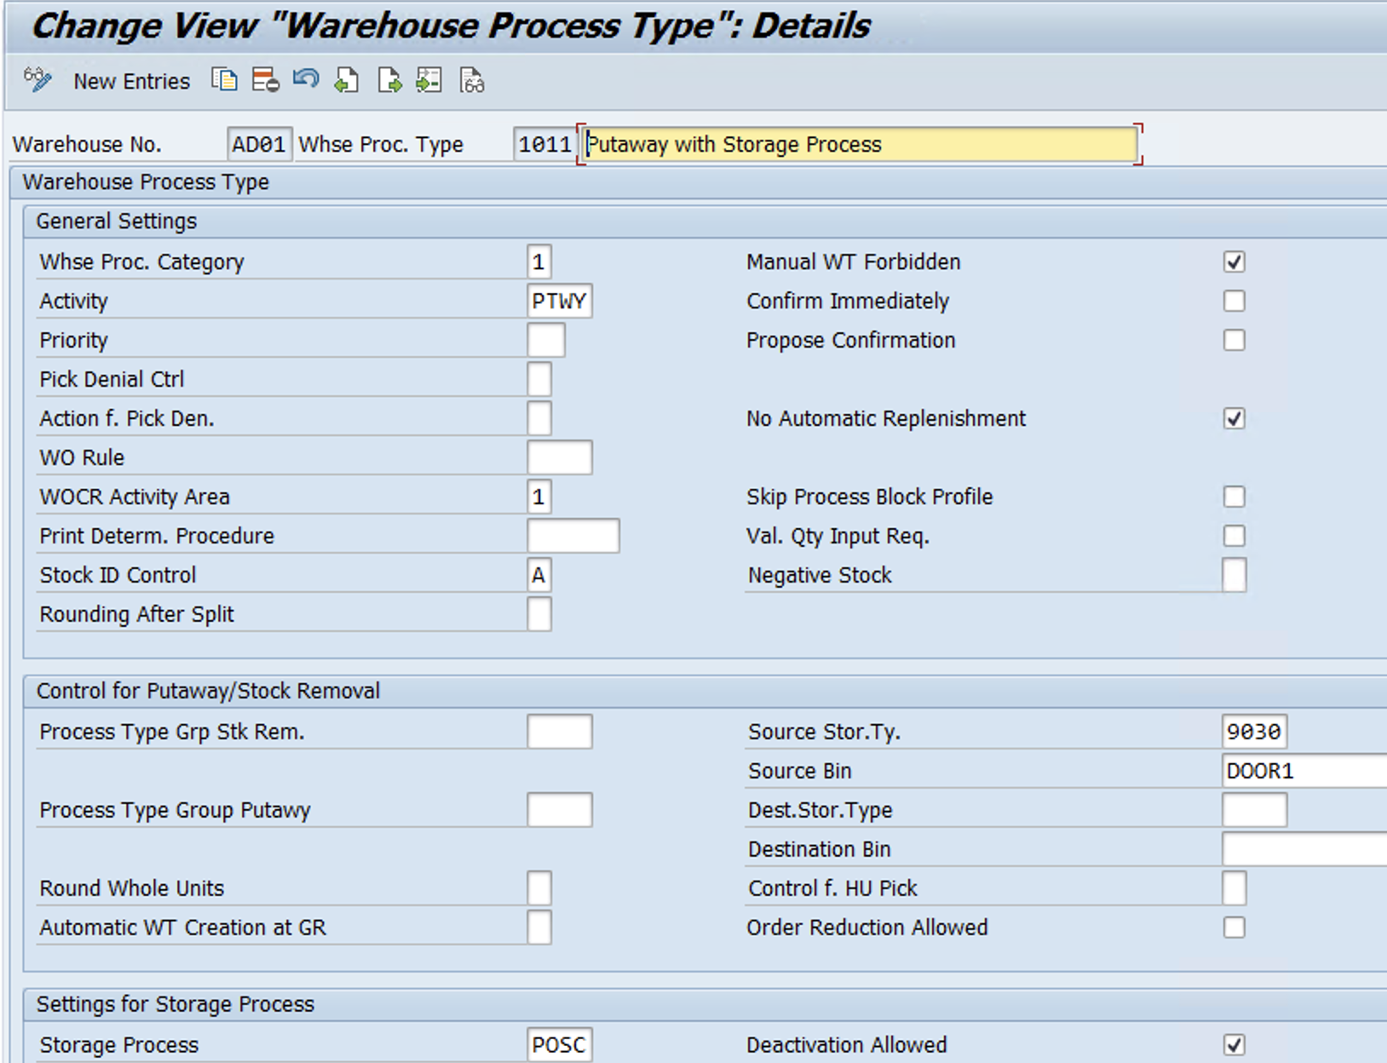
Define WHPT for Putaway (Using Storage process)
www.anubhavtrainings.com

Slide 27
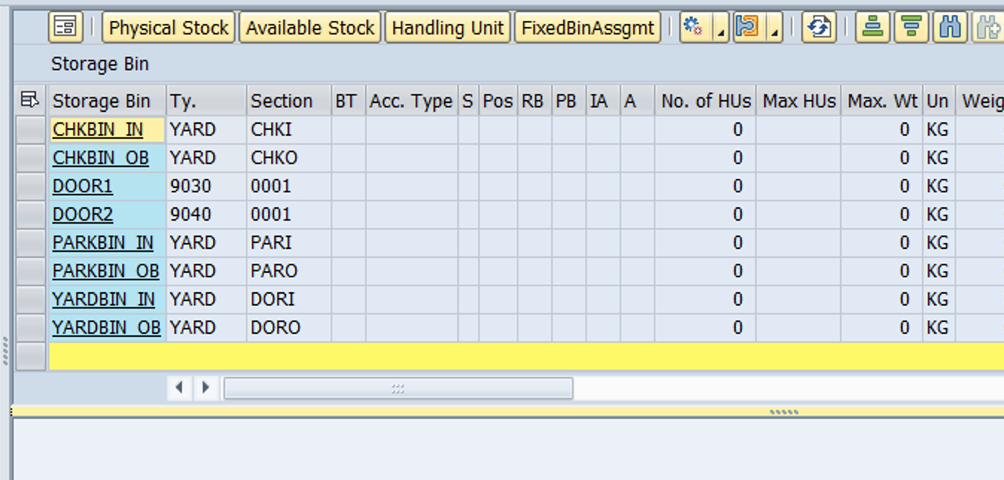
Create Door Storage Bins for 9030 & 9040 Storage types & for YARD Storage type as shown below -
www.anubhavtrainings.com

Slide 28
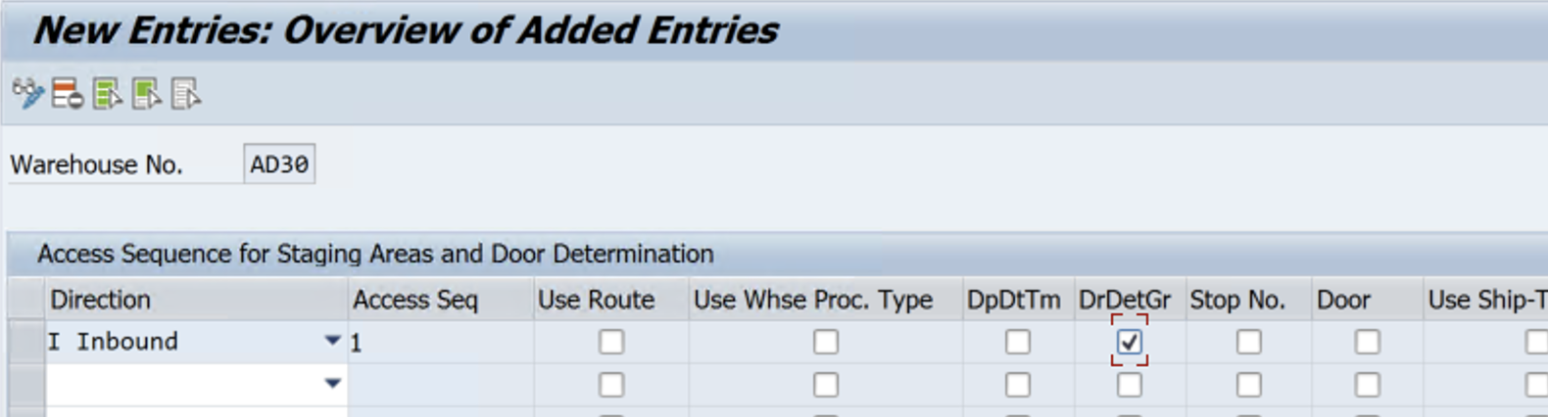
Staging area determination criteria/Access seq
Tcode - /scwm/stadet_ass
www.anubhavtrainings.com

Slide 29
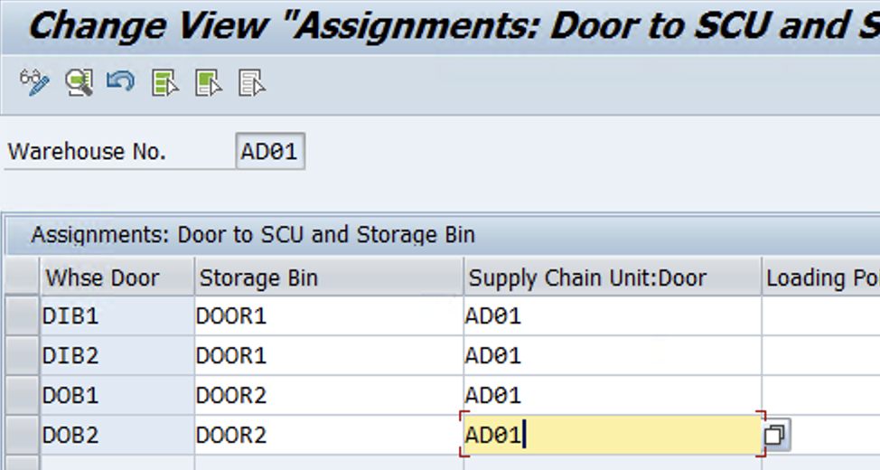
Assign Warehouse Doors to Door Storage bins & Supply chain units
Tcode - /scwm/door_scu
www.anubhavtrainings.com

Slide 30
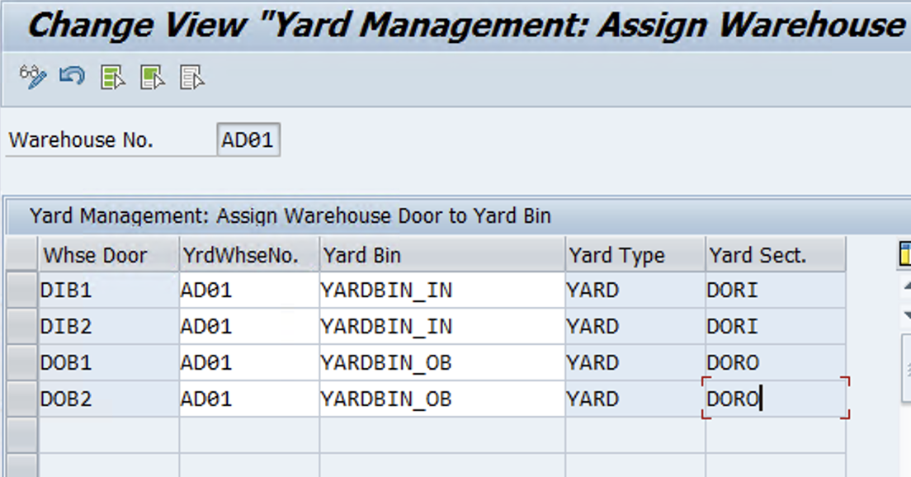
Assign Warehouse Door to Yard bin - /scwm/ym_door_bin
www.anubhavtrainings.com

Slide 31
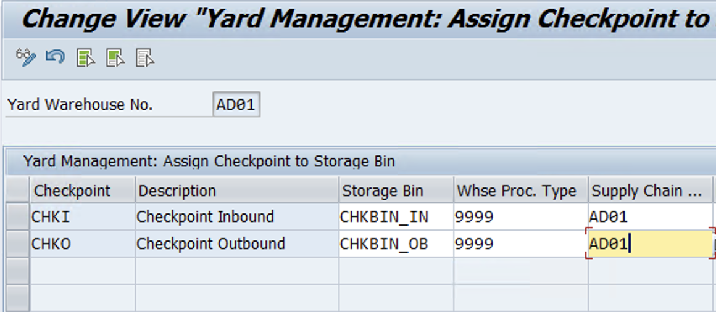
Assign Checkpoints to Storage bins - /SCWM/YM_CHKPT_BIN
www.anubhavtrainings.com

Slide 32
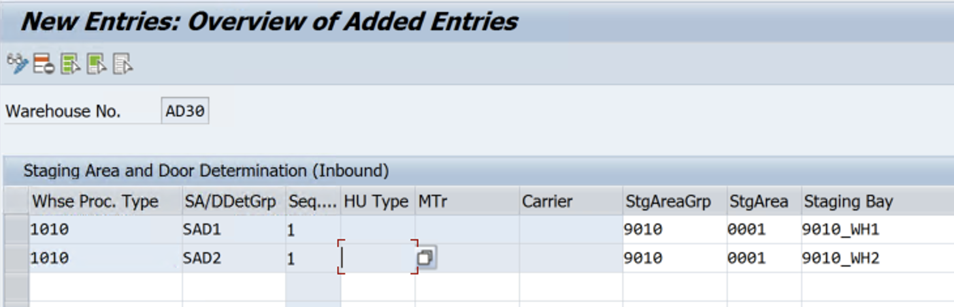
Staging area Determination by SADG
Tcode - /scwm/stadet_in
www.anubhavtrainings.com

Slide 33
Test Case
Create TU - /scwm/tu
Assign IBD & Door to TU
Arrival at Check Point - /scwm/cico
If All Doors are engaged, Create WT to Move from Checkpoint to Parking bin - /scwm/ymove
Create WT to Move from Parking bin to Door (Docked at Door) - /scwm/ymove
Goods receipt in IBD
Unloading Task Creation & Confirmation
Check IBD status - Unloading will be completed!
Create a WT to Move TU back to Checkpoint - /scwm/ymove
Departure from Checkpoint - /scwm/cico
Complete your Putaway Tasks
www.anubhavtrainings.com

Slide 34
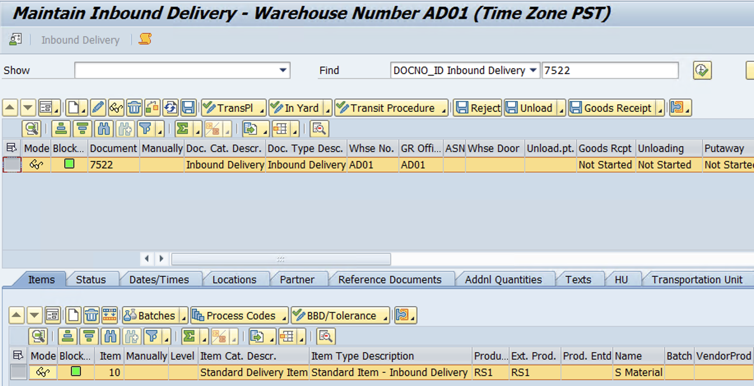
Create IBD
www.anubhavtrainings.com

Slide 35
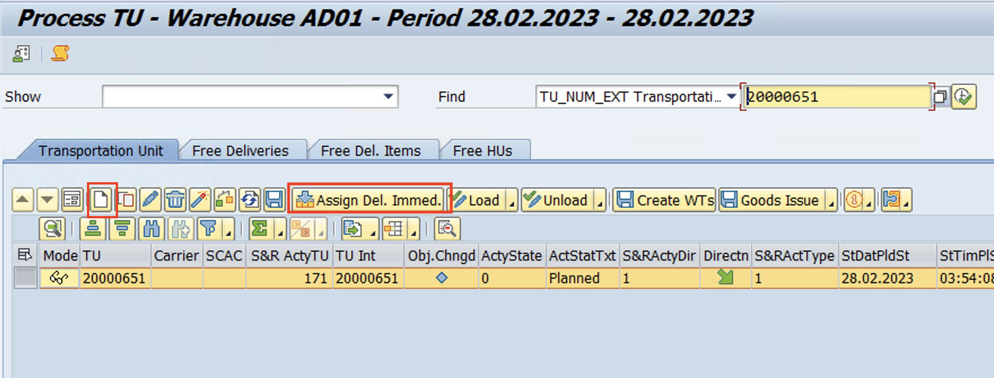
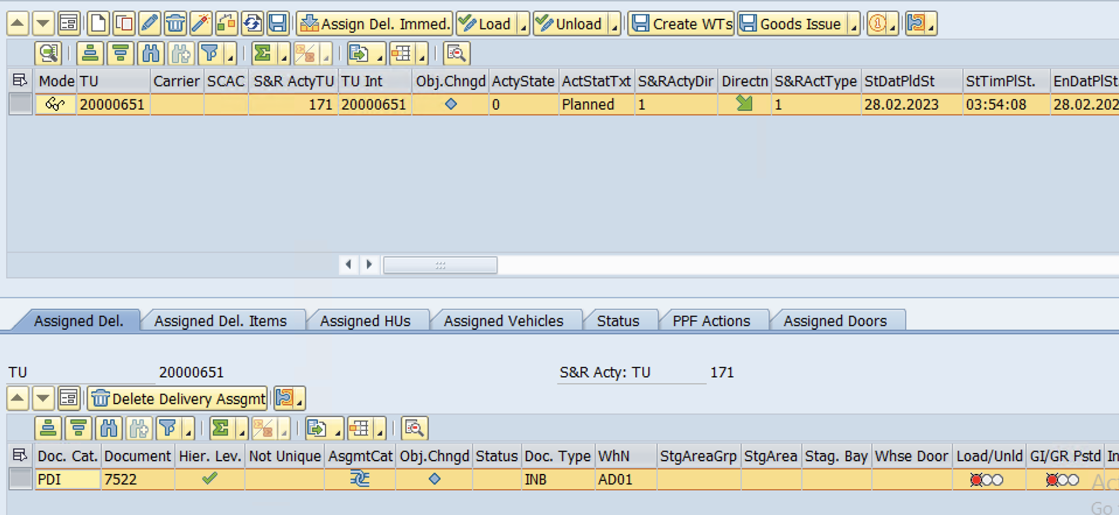
Create TU using tcode - /scwm/tu
Assign Inbound delivery to TU
www.anubhavtrainings.com

Slide 36
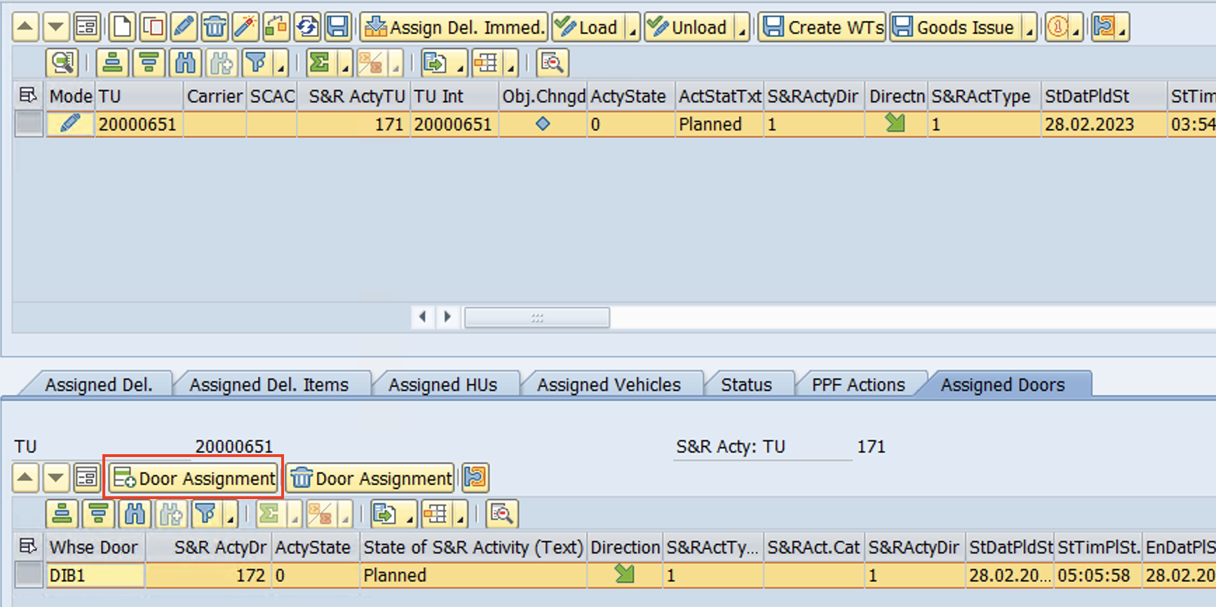
Assign Door
www.anubhavtrainings.com

Slide 37
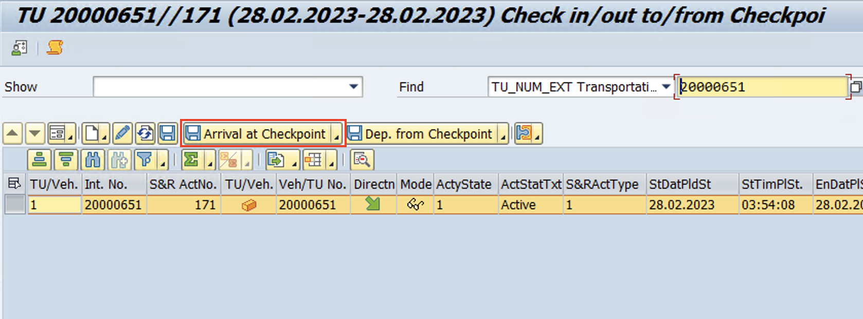
Arrival at Check Point - /scwm/cico
Status changed to “Active” and IBD Transit status changed to “Registered in Yard”
www.anubhavtrainings.com

Slide 38
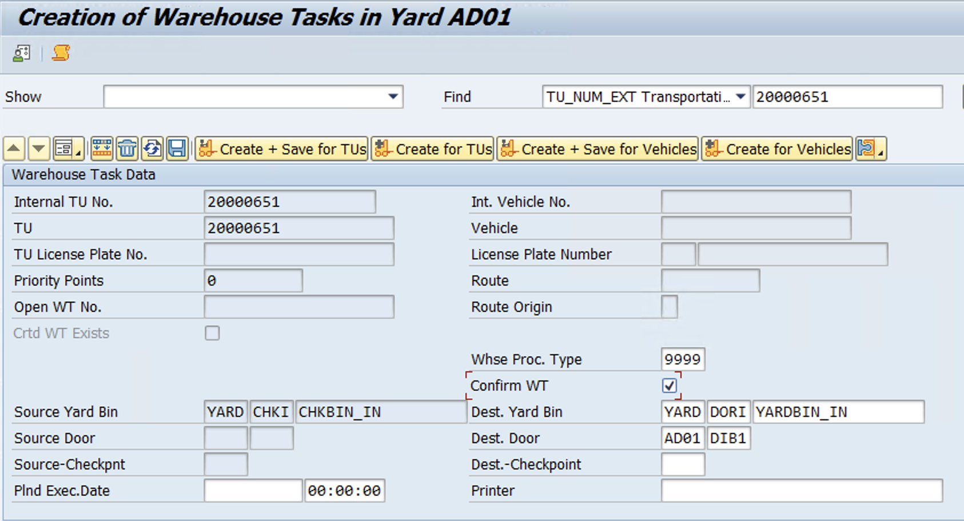
If All Doors are engaged, Create WT to Move from Checkpoint to Parking bin -
/scwm/ymove
www.anubhavtrainings.com

Slide 39
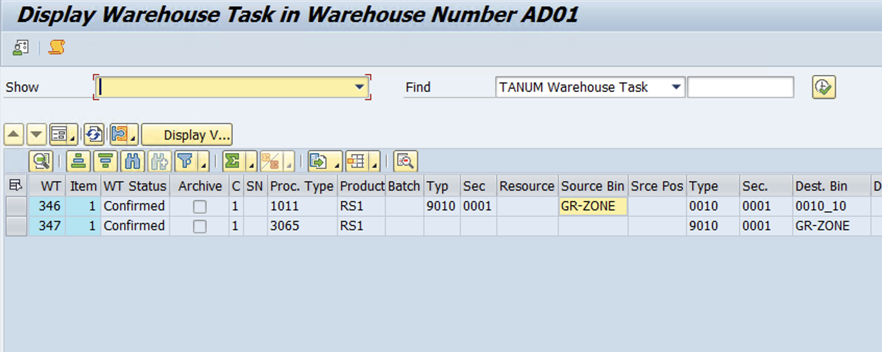
Create Warehouse Task for unloading into GR-ZONE
IBD > Follow on functions > WT
2 WTs will get created, 1st WT for Unloading into GR Zone and 2nd WT (Status B) for Moving from GR Zone to Final bin as per POSC config.
Confirm the 1st WT >> 2nd WT status will updated B to Blank >> Confirm 2nd WT.
Check Inbound Delivery Status
www.anubhavtrainings.com

Slide 40
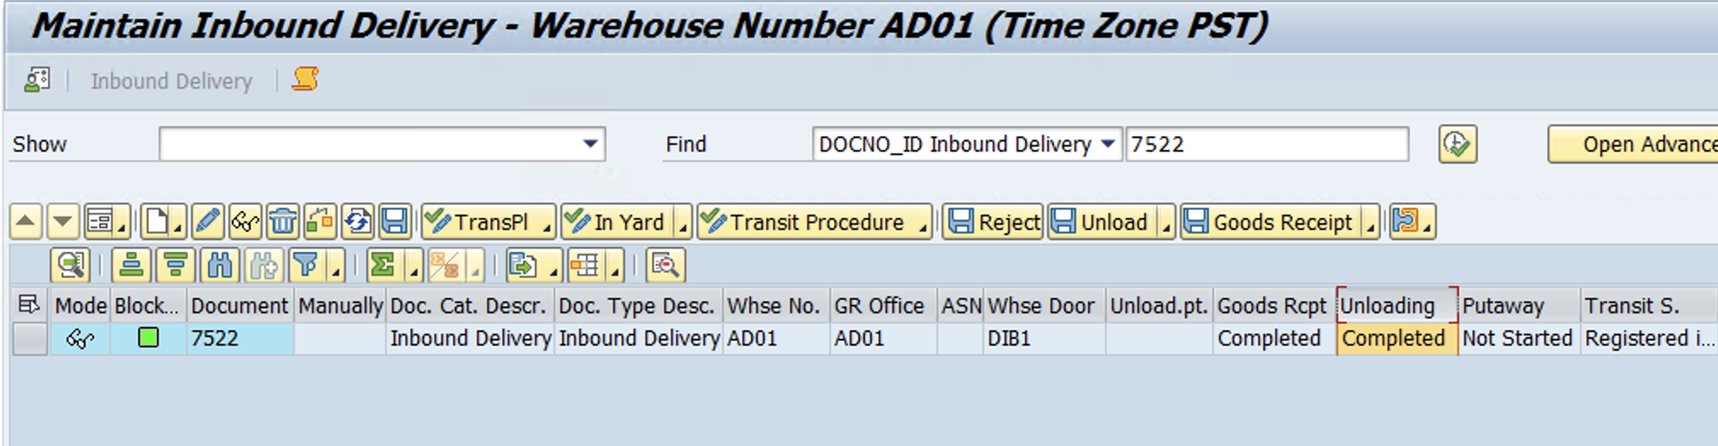
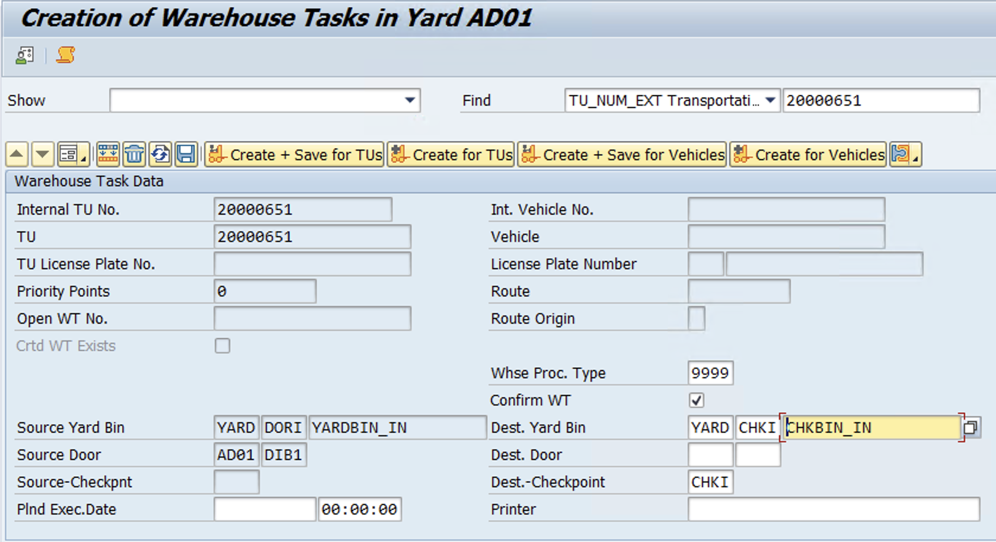
Move the truck back to the checkpoint by creating a warehouse task using the t-code: /SCWM/YMOVE
www.anubhavtrainings.com

Slide 41
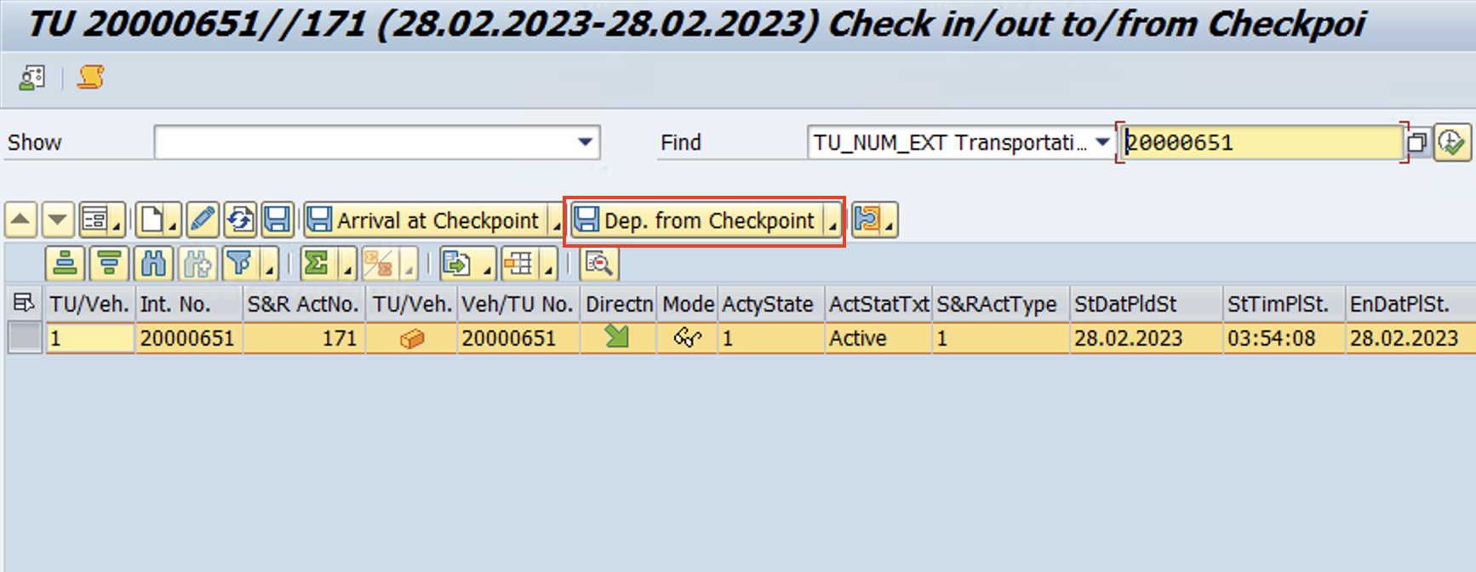
Departure from Checkpoint - /scwm/cico
www.anubhavtrainings.com

Slide 42
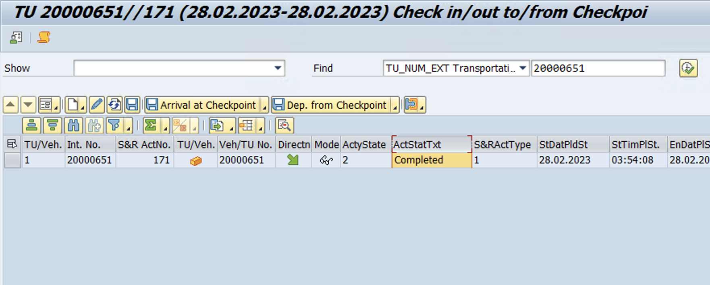
www.anubhavtrainings.com

Slide 43


End of Session 11
www.anubhavtrainings.com

Slide 44

FEEL FREE TO ASK QUESTIONS

Slide 45

Feedback

Slide 46
THANK
YOU

Slide 47




More from AnubhavTrainings.com

Slide 48






We’re committed to empower you to be
#FutureReady
through powerful training solutions.
We build the workforce of the future.
250+
Corporate Clients
30,000+
Learners Trained
25000+
Learners Placed
FREE WEBINARS
Sign up for free webinars with industry experts every fortnight!
Enroll Now!

Slide 49
FREE WEBINARS
Sign up for free webinars with industry experts every fortnight!
Contact us today!
www.anubhavtrainings.com

